Slide 1
Church of Christ

Slide 2
Is The Church of CHRIST A Biblical Church?
“Serving God By Faith”
The NT Pattern For Edification

Slide 3
Is The Church of CHRIST A Biblical Church?
Walking By Faith

Slide 4
Is The Church of CHRIST A Biblical Church?
Therefore, just as the church is subject to Christ,… Eph 5:24
The N.T. Pattern For The
Organization of A Local Church
Christ the head
Elders (bishops, pastors)
Deacons to serve
Evangelist, teachers & saints
Worship of A Local Church
The Lord’s Supper
Giving To The Lord’s Work
Teaching the scriptures
Praying together
Music

Slide 5
The N.T. Pattern For The
Work of A Local Church
We ARE NOT free to involve the church in whatever work we deem suitable!
There is a distinction to be made between the church "universal" and the church “local.”
The work of the local church can be gleaned in some respects from what is revealed about it’s organization and worship.

Slide 6
Work of A Local Church
Self-Edification, i.e. to build up and strengthen itself (Acts 20:28, 32; Col 2:6, 7).
Evangelism - Preach the gospel to the lost (Mat 28:18-20).
Benevolence – Providing the needs of destitute Christians (Acts 6:1-4)

Slide 7
Work of A Local Church
How Is The Church To Fund The Work That It Does?
By the free will offerings of it’s members - 1 Cor. 16:1,2
Addressing our needs –
Benevolence – 1 Cor 16:1,2; 2 Cor 8,9
Preaching – 2 Cor 11:8,9; Phili 4:10-18
Edification – Eph 4:11-16; 1 Thes 5:11

Slide 8
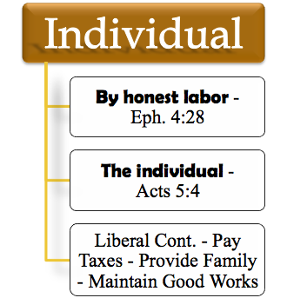
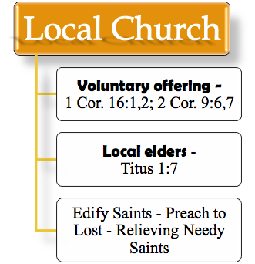
The N.T. Pattern For The
Work of A Local Church
Method raising
Over-sight
Use

Slide 9
The N.T. Pattern For The
Work of A Local Church
EDIFICATION - Defined
1. Vines - OIKODOMEµ, (3619)) denotes (a) the act of building (oikos, a home, and demoµ, to build); this is used only figuratively in the N.T., in the sense of edification, the promotion of spiritual growth (lit., the things of building up),
2. Thayer - 1) (the act of) building, building up; 2) metaph. edifying, edification - the act of one who promotes another’s growth in Christian wisdom, piety, happiness, holiness

Slide 10
The N.T. Pattern For The
Work of A Local Church
EDIFICATION - In Practice
By Preaching – 2 Tim. 4:2; Col. 1:28
By Teaching –Rom. 12:7; Acts 15:35; 18:11; 28:31
By Example / Doing – Rom. 14:19:15:2; Eph. 4:29; 1 Thes. 5:11-12; Mat 25:29; Heb 5:12-14; Js. 1:21-25

Slide 11
The N.T. Pattern For The
Work of A Local Church
EDIFICATION - In Practice
In the assembly by preaching, teaching, singing, and praying – 2 Tim. 4:2; Col. 1:28; Eph 5:19; Col 3:16; Jude 1:20; Acts 4:31
Bible classes – where individuals are taught the scriptures based on their ability to understand – (building, homes, public places, etc.)

Slide 12
The N.T. Pattern For The
Work of A Local Church
EDIFICATION - In Practice
Jesus & His disciples - Mat 24:3
The apostles & hearers in Acts 2 – Acts 2:5-14
Paul & those of reputation - Gal 2:2
Aquila, Priscilla & Apollos - Acts 18:26
Both men & women – Tit 2:1-12

Slide 13
The N.T. Pattern For The
Work of A Local Church
EDIFICATION - In Practice
Young men
Titus 2:2,6
Aged men
Young women
Titus 2:3,4
Aged women
Children
Eph 6:1-4
Parents
Husbands
Eph 5:22-25
Wives
Babes in Christ
1 Pet 2:2; Heb 5:12-14
Mature

Slide 14
The N.T. Pattern For The
Work of A Local Church
EDIFICATION - In Practice

Slide 15
Baptize
(Mt. 28:18-20)
Pool, River, Baptistery, Etc.
Basin to Sprinkle – Cup for Pouring
Assemble
(Heb. 10:24-25)
House, Hall, Church Building
Family Life Center, Gymnasium, Etc.
Lord’s Supper
(1 Cor. 11:23-29)
Cups, Plates, Table, Etc.
Social Meal
(1 Co. 11:17-22, 34)
Give (1 Cor. 16:1-2)
Collection Baskets
Raffle Tickets, Chili Suppers, Cake Walks, Etc.
Sing (Eph. 5:19)
Song Book, Leader,
Faithful Saints
Piano, Guitars, Organ, Violin, Etc.
Edify/ Teach
(Mat 28:18-20; Acts 20:28; 1 Thes 5:11)
Bible Material, Place/Room, Chalk Board, Maps, PPT
Secular Education, Entertainment, Athletics, etc.

Slide 16
The N.T. Pattern For The
Work of A Local Church
We ARE NOT free to involve the church in whatever work we deem suitable!
There is a distinction to be made between the church "universal" and the church “local.”
The work of the local church can be gleaned in some respects from what is revealed about it’s organization and worship.

Slide 17
The N.T. Pattern For The
Work of A Local Church
Self-Edification, i.e. to build up and strengthen itself (Acts 20:28, 32; Col 2:6, 7).
Evangelism - Preach the gospel to the lost (Mat 28:18-20).
Benevolence – Providing the needs of destitute Christians (Acts 6:1-4)

Slide 18
What Must One Do To Be Saved!!!!!!!!!!
Hear The Gospel – Romans 10: 17 “Faith Comes by hearing and hearing by the word of God.”
Believe The Gospel – Mark 16: 16
“ He that believeth and is baptized shall be saved, and he that believeth not shall be damned.”
Repent of Sins – Luke 13: 3 “Repent or You will Perish”
Confess Christ – Romans 10: 9-10 “That if thou shalt confess with thy mouth the Lord Jesus, and shalt believe in thine heart that God raised him from the dead, thou shall be saved. For with the heart man believeth unto righteous; and with the mouth confession is made unto salvation.”
Be Baptized – Acts 2: 38
“Repent and be baptized everyone of you in the name of Jesus Christ for the remission of sins, and you shall receive the gift of the Holy Spirit.”

