Slide 1
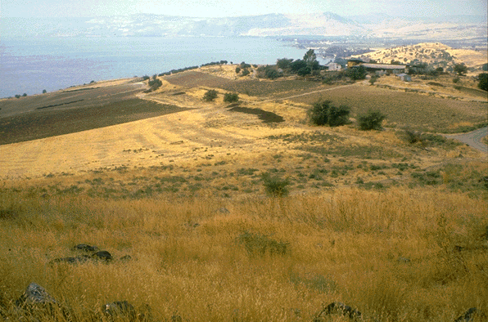
Sin Is Always Wrong

Slide 2
Isaiah 55:6-9
Seek ye the Lord while he may be found,
call ye upon him while he is near: Let the wicked forsake his way, and the unrighteous man his thoughts: and let him return unto the Lord, and he will have mercy upon him;and to our God, for he will abundantly pardon.
For my thoughts are not your thoughts,
neither are your ways my ways, saith the Lord.
For as the heavens are higher than the earth,
so are my ways higher than your ways,
and my thoughts than your thoughts.

Slide 3
God hates sin.
God takes note of those who sin.
God will judge those who are in sin when they die.
God will punish those in sin when they die.

Slide 4
The word “Sin” comes from the Greek word
Hamartia
that means “to miss the mark”.
Strongs G266

Slide 5
Sin is Inexcusable

Slide 6
Roman 2:1-4
Therefore thou art inexcusable, O man, whosoever thou art that judgest: for wherein thou judgest another, thou condemnest thyself; for thou that judgest doest the same things. But we are sure that the judgment of God is according to truth against them which commit such things. And thinkest thou this, O man, that judgest them which do such things, and doest the same, that thou shalt escape the judgment of God?

Slide 7
What is Sin ?

Slide 8
James 2:10
For whosoever shall keep the whole law,
and yet offend in one point, he is guilty of all.

Slide 9
Sin is transgression of God’s law.
1 John 3:4 “Everyone who practices sin also practices lawlessness; and sin is lawlessness”.

Slide 10
WHY DO WE SIN?

Slide 11
1 John 3:9
Whosoever is born of God doth not commit sin; for his seed remaineth in him: and he cannot sin, because he is born of God.

Slide 12
2 Thessalonians 2:10-12
And with all deceivableness of unrighteousness in them that perish; because they received not the love of the truth, that they might be saved. And for this cause God shall send them strong delusion, that they should believe a lie: That they all might be damned who believed not the truth, but had pleasure in unrighteousness.

Slide 13
We Refuse to Walk with God

Slide 14
And Enoch walked with God: and he was not; for God took him.
Gen 5:24

Slide 15
Heb 11:5
By faith Enoch was translated that he should not see death; and was not found, because God had translated him: for before his translation he had this testimony, that he pleased God.

Slide 16
It is a Sin to reject the
word of GOD

Slide 17
Sin will take you farther than you want to go, keep you longer than you want to stay, and cost you more than you want to pay.

Slide 18
We Can Sin: Even If We Do Not Know Better
Ignorance is no excuse
Acts 3:17 “And now, brethren, I know that you acted in ignorance, just as your rulers did also”.
Acts 3:19 “Repent therefore and return, that your sins may be wiped away, in order that times of refreshing may come from the presence of the Lord:”
Hosea 4:6 “My people are destroyed for lack of knowledge, because you have rejected knowledge, I also will reject you from being My priests, Since you have forgotten the law of your God, I also will forget your children.

Slide 19
We Can Sin: Even If It Is Not As Bad As What Someone Else Did
James 2:9-10 “But if you show partiality, you are committing sin and are convicted by the law as transgressors. For whoever keeps the whole law and yet stumbles in one point, he has become guilty of all”.
So, who are we to compare ourselves to?
Ourselves?
Proverbs 16:2 All the ways of a man are clean in his own eyes;but the Lord weigheth the spirits.

Slide 20
We Can Sin: Even If We Were Trying To Do Good
David sinned trying to bring the ark home.
Uzzah paid the penalty for this sin (2 Samuel 6:1-7).
Does the end justify the means?
A lot of people think so, but does it make it right?
Truth can be hurtful—Truth can turn people off if handled wrongly.
Need for wisdom. James 1:5 “But if any of you lacks wisdom, let him ask of God, who gives to all men generously and without reproach, and it will be given to him”.
Ephesians 4:15 “but speaking the truth in love, we are to grow up in all aspects into Him, who is the head, even Christ,.”

Slide 21
We Can Sin: Even If Someone Else Influenced Us
Genesis 3:12,13 “And the man said, ‘the woman whom Thou gavest to be with me, she gave me from the tree, and I ate’. Then the LORD God said to the woman, “What is this you have done?” And the woman said, ‘the serpent deceived me and I ate”.
The blind leaders Matthew 15:14 “Leave them! They are blind guides. If someone who is blind leads another who is blind, both will fall into a pit”.
Teachers of error—error will still cause a soul to be lost no matter how sincere they are.

Slide 22
We Can Sin: Even If It Is Legal
Acts 5:29 “But Peter and the apostles answered and said, ‘we must obey God rather than men’”.
Divorce for any cause: Matthew 5:32: 19:9
Drinking Alcohol, Drugs, Legal Drugs, Marijuana
Lawsuits against brethren.
Etc

Slide 23
We Can Sin: Even If Everyone Else Does It
Remember what Mama said when you used this argument?
Matthew 7:13: “Enter by the narrow gate; for the gate is wide, and the way is broad that leads to destruction, and many are those who enter by it”.

Slide 24
Conclusion
So many reasons offered for participating in sin still does not make it right.
God will judge us.
Many passages that warn us about the consequence of sin, especially if it is not repented, turned away from, and acknowledged in confession.
A total effort is necessary on our part of overcome sin.
Revelation 2:7 He that hath an ear, let him hear what the Spirit saith unto the churches; To him that overcometh will I give to eat of the tree of life, which is in the midst of the paradise of God.
Why not remove the sin from YOUR life?

Slide 25
What you must do to be saved
Preaching Believed Repented Confessed Baptized
Pentecost Believed, 2: 36 Repented, 2: 38 Baptized, 2: 38
Samaria Believed, 8: 12 Baptized, 8: 12
Eunuch Believed, 8: 37 Confessed, 8: 37 Baptized, 8: 38
Saul Baptized, 22: 16
Cornelius Believed, 10: 43 Baptized, 10: 48
Jailer Believed, 16: 31 Repented, 16: 33 Baptized, 16: 33
Lydia Believed, 16: 14 Baptized, 16:15
Preaching Faith Repentance Confession Baptism
Rom. 1: 16 Rom. 10: 17 Acts 17: 31 Rom. 10: 9, 10 Gal. 3: 27
Notes:
Slide five shows from the History Book how people became Christians. Pristine Christianity today involves the same process.

