Slide 1
Never, Never Give Up

Slide 2
Never, Never Give Up on the Bible

Slide 3
1 John 2:5 “But whoso keepeth his word, in him verily is the love of God perfected: hereby know we that we are in him”

Slide 4
1 Pet 1:23-25 “Being born again, not of corruptible seed, but of incorruptible, by the word of God, which liveth and abideth for ever. For all flesh is as grass, and all the glory of man as the flower of…

Slide 5
1 Pet 1:23-25 …grass. The grass withereth, and the flower thereof falleth away: But the word of the Lord endureth for ever. And this is the word which by the gospel is preached unto you”

Slide 6
1 John 1:1-4 “That which was from the beginning, which we have heard, which we have seen with our eyes, which we have looked upon, and our hands have handled, of the Word of life; (For the life…

Slide 7
1 John 1:1-4 …was manifested, and we have seen it, and bear witness, and shew unto you that eternal life, which was with the Father, and was manifested unto us;) That which we have seen and…

Slide 8
1 John 1:1-4 …heard declare we unto you, that ye also may have fellowship with us: and truly our fellowship is with the Father, and with his Son Jesus Christ. And these things write we unto you, that your joy may be full”

Slide 9
Never, Never Give Up on the the Lord’s Church

Slide 10
Acts 2:47 “Praising God, and having favour with all the people. And the Lord added to the church daily such as should be saved”

Slide 11
Eph 5:23 “For the husband is the head of the wife, even as Christ is the head of the church: and he is the saviour of the body”

Slide 12
Eph 1:4 “According as he hath chosen us in him before the foundation of the world, that we should be holy and without blame before him in love”

Slide 13
Never, Never Give Up on the marriage and the home

Slide 14
Heb 13:4 “Marriage is honourable in all, and the bed undefiled: but whoremongers and adulterers God will judge”

Slide 15
Marriage is a divine institution
John 2 Jesus first miracle was at Cana of Galilee at a wedding.

Slide 16
Gen 3:20 “And Adam called his wife's name Eve; because she was the mother of all living”

Slide 17
Never, Never Give Up on Heavenly Hope

Slide 18
Titus 1:2 “In hope of eternal life, which God, that cannot lie, promised before the world began”

Slide 19
Psa 39:7 “And now, Lord, what wait I for? my hope is in thee”

Slide 20
Heb 6:18-19 “That by two immutable things, in which it was impossible for God to lie, we might have a strong consolation, who have fled for refuge to lay hold…

Slide 21
Heb 6:18-19 …upon the hope set before us: Which hope we have as an anchor of the soul, both sure and stedfast, and which entereth into that within the veil”

Slide 22
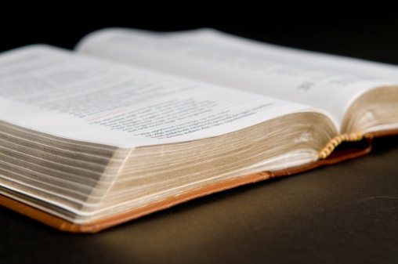
Never, Never Give Up, Examples in God’s Word

Slide 23
Noah never gave up!

Slide 24
Joseph never gave up!

Slide 25
Moses never gave up!

Slide 26
Paul never gave up!

Slide 27
2 Tim 4:6-8 “For I am now ready to be offered, and the time of my departure is at hand. I have fought a good fight, I have finished my course, I have kept the…

Slide 28
2 Tim 4:6-8 …faith: Henceforth there is laid up for me a crown of righteousness, which the Lord, the righteous judge, shall give me at that day…

Slide 29
2 Tim 4:6-8 …and not to me only, but unto all them also that love his appearing”

Slide 30
Never, Never Give Up on the, Bible, Church, Home, and Hope!

Slide 31
God has Never, Never Given Up on “US"

Slide 32
Rom 10:17 “So then faith cometh by hearing, and hearing by the word of God”

Slide 33
Acts 2:38 “Then Peter said unto them, Repent, and be baptized every one of you in the name of Jesus Christ for the remission of sins, and ye shall receive the gift of the Holy Ghost”

Slide 34
Phil 2:11 “And that every tongue should confess that Jesus Christ is Lord, to the glory of God the Father”

Slide 35
Gal 3:27 “For as many of you as have been baptized into Christ have put on Christ”

Slide 36
Matt 24:13-14 “But he that shall endure unto the end, the same shall be saved. And this gospel of the kingdom shall be preached in all the world for a witness unto all nations; and then shall the end come”

Slide 37
Hear
Believe
Repent
Confess
Baptized

